Slide 1


Department of Computer Science
University Institute of Engineering
DEPARTMENT OF COMPUTER SCIENCE & ENGINEERING
Bachelor of Engineering
Subject Name: System Programming
Subject Code: CST-315
Debuggers
DISCOVER . LEARN . EMPOWER

Slide 2
Chapter- 1.1 Overview of System Software
Department of computer Science
Tools
Life Cycle of a Source Program

Slide 3
Life Cycle of a Source Program
The life cycle of a source program defines the program behavior and extends through execution stage, which exhibits the behavior specified in the program.
Every source program goes through a life cycle of several stages.
Edit time: It is the phase where editing of the program code takes place and is also known as design time. At this stage, the code is in its raw form and may not be in a consistent state.
Compile time: At the compile time stage, the source code after editing is passed to a translator that translates it into machine code. One such translator is a compiler. This stage checks the program for inconsistencies and errors and produces an executable file.
Distribution time: It is the stage that sends or distributes the program from the entity creating it to an entity invoking it. Mostly executable files are distributed.

Slide 4
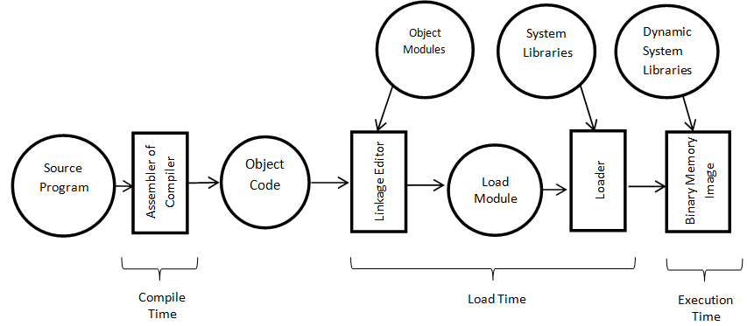
Life Cycle of a Source Program
Installation time: Typically, a program goes through the installation process, which makes it ready for execution within the system. The installation can also optionally generate calls to other stages of a program's life cycle.
Life Cycle of a Source Program

Slide 5
Life Cycle of a Source Program
Link time: At this stage, the specific implementation of the interface is linked and associated to the program invoking it. System libraries are linked by using the lookup of the name and the interface of the library needed during compile time or throughout the installation time, or invoked with the start or even during the execution process.
Load time: This stage actively takes the executable image from its stored repositories and places them into active memory to initiate the execution. Load time activities are influenced by the underlying operating system.
Run time: This is the final stage of the life cycle in which the programmed behavior of the source program is demonstrated.

Slide 6
Tools
There are different source code management tools available for use and a lot of them are also open-source and free to use. Depending on the team’s requirements, an appropriate tool can be used.
Tools integrating project management and build pipeline features are GitLab and Team Foundation Server.
For on-premise setup, teams can use Git, Subversion, CVS, etc.
For example, if Git is the chosen tool, you can create all your source code and just type git init
This command will initialize all the settings and files required for Git to function properly. Once you commit/staging your code, it will be available as a Git repository for others to download/contribute.

Slide 7
Comparing Top Source Code Management Software
Github Enables large development teams to collaborate, review, and manage software or application code
• Offers free trial • Team: $4 per user/month • Enterprise: $21 per user/month
Bitbucket One-stop solution for versioning, project management, and collaboration across teams of any size
• Free for small teams with up to 5 members • Standard and Premium come at $3 and $6 per user/month, respectively

Slide 8
Comparing Top Source Code Management Software
Gitlab Used for end-to-end project lifecycle with git-based tools: version control, project management, CI/CD
• Free for individuals • Premium and Ultimate editions come at a cost of $19 and $99 per user/month, respectively
Team Foundation Server Enterprise-grade source control management tool that supports integration with most of the existing IDEs
• Offers free trial • Basic Plan: $2 per user/month • Azure Pipelines: $15 per parallel job
Apache Subversion Open-source version control system supporting file locking and merge tracking
• Open source: deployed on premise and is free to use

Slide 9
References
Department of computer Science
[PDF] Systems Programming and Operating Systems by Dhamdhere - Free Download PDF (dlscrib.com)
[PDF] Principles of Compiler Design By Alfred V. Aho & J.D.Ullman Free Download – Learnengineering.in

Slide 10

THANK YOU

